Slide 1
Lockdown streaming’s effect on carbon emissions
NETFLIX & COVID
488.001 Epsilon 1

Slide 2






Our Team
Crystal Baker
Brooke Bordonaro
Gabe Bouslov
Natalie McDonald
Jackson Watkins
Madison Zezzo

Slide 3
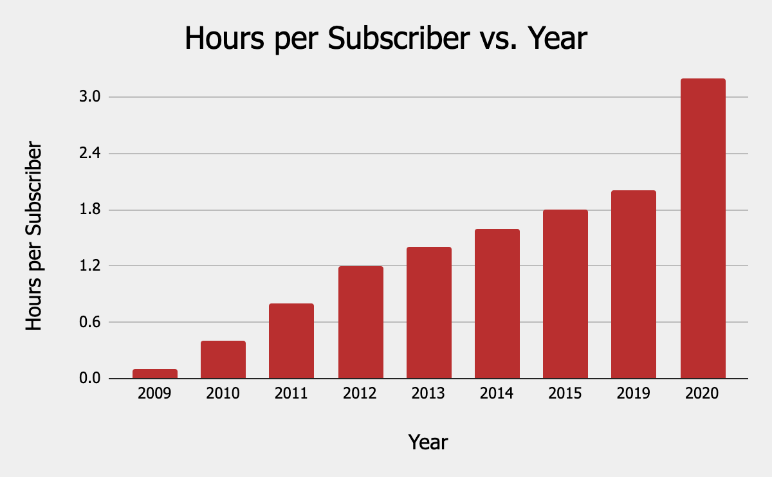
covid-19 increased Netflix streaming habits
36.57 M
60%
80.9%
New Subscribers
in 2020
Increase in Daily Usage
for the average subscriber
Increase in stock price
during the 2020 lockdown
Notes:
Jackson
36.57 million new members joined Netflix in 2020. This is an increase of 31.4% from the previous year; this is a jump from 27.83 million to 36.57 million
The daily usage, as measured by the number of hours per subscriber, increased 60% from 2019 to 2020; this is a jump from 2 hours to 3.2 hours
NOTE: per subscriber means per paying account, but each account may have numerous users (essentially 3.2 is the average usage per account, not per person)
Netflix’s stock price increase from $298.84 to $540.73 from March 13th, when COVID was declared a National Emergency to the end of 2020; this is an increase in share price of 80.9%

Slide 4
Netflix CORE CUSTOMER AUDIENCES
70%
30%
Viewing Screens
2020 Global Subscribers
38%
11%
32%
19%
TV
OTHER
Notes:
Before we dive into calculating emissions from Netflix, let’s briefly touch on how and where subscribers are using Netflix.
In the graph to the left, we can see that 70% of users are viewing their shows on TVs, while the other 30% watch Netflix on phones, tablets, or PCs. This will be important later when we calculate electricity consumption of different devices.
Next, we can look at the locations of Netflix subscribers. From the map, we can see that 38% resides in the US or Canada; 19% in Latin America; 32% in Europe, Africa, or the Middle East; and 11% in the Asia-Pacific region. We note these percentages because each region’s energy generation will affect overall emissions (90% of France’s electricity comes from low-carbon sources, so less emissions than other countries).

Slide 5
What Effect Has Increased Streaming Had on Carbon emissions and how do people feel about it?
1.
2.
3.
Our Strategy
Our goal is to determine the environmental impact of Netflix’s increase in streaming and the effect it has on consumer sentiment to make a recommendation that is benefits the business and the Earth.
Notes:
Strategy:
Outside research to Gather Data: Subscribers per year, streaming, streaming to energy conversion, etc.
Predicting Carbon Emissions in the future based on current/past trends: How much worse will it get?
Twitter Sentiment Analysis: easy access to people’s verbatim opinions

Slide 6
203,660,000
3.2 Hours
.077 kWh
Global Netflix Subscribers in 2020
A subscribers average time watching in 2020
Energy used per hour of streaming
iea.org
Notes:
Now lets dive into some fun facts about Netflix and Streaming. In 2020, there were a whopping 204 million global netflix subscribers - roughly equivalent to three times the population of the entire United Kingdom. These subscribers spend 3.2 hours per day watching Netflix. This number seems way too big and rightfully so - these figures are per Netfix account which could include multiple watchers. The most accurate estimates place an hour of streaming as equivalent to .077 kWh.
This then gives us a total of…..
Energy used per hour of streaming: https://www.iea.org/commentaries/the-carbon-footprint-of-streaming-video-fact-checking-the-headlines
Global netflix subscribers: https://www.washingtonpost.com/business/2021/04/20/netflix-new-subscriber-numbers/
Subscribers average time watching: https://backlinko.com/netflix-users
Multiplied together gives us: 18706688000 kWh

Slide 7



The Electrical Footprint of Netflix Streaming
18,316,364,300
kWh of electricity used in 2020
12.7 Billion
407 Billion
1.02 Trillion
equivalent hours of usage
michaelbluejay.com
Notes:
18 billion, 300 and sixteen million, 364 thousand 300 kWh of electricity used per year. How much is that? That’s the equivalent of running 12.7 billion microwaves for an hour or 407 laptops for an hour or just over a trillion light bulbs. Doesn’t actually seem like all that much right? It’s important to take a look at how this translates to carbon footprint.
1.44 kWh per microwave hour https://michaelbluejay.com/electricity/howmuch.html
.045 kWh per laptop hour
.018 kWh per CFL bulb hour
We got this large number by multiplying 203660000*3.2*365*.077.

Slide 8




The Carbon Footprint of Netflix Streaming
16,851,057,200
pounds of CO2 emitted in 2020
1,831,636
821,029,8200
.00025%
Cambodia OR Honduras
more pounds of CO2 than emitted in 2019
Percentage of global carbon emissions
Have roughly equivalent yearly emissions of fossil fuel CO2
Cars output the same amount of CO2 per year
Notes:
The carbon footprint of netflix streaming is equivalent to 16.85 billion pounds of CO2 emitted per year. Roughly equivalent to the emissions of Cambodia or Honduras, or 1.83 million cars. This comes down to about .00025% of all global carbon emissions - whether this percentage seems large or not depends on which perspective you look at it from. This is one company after all!
Carbon footprint calculation = .92 pounds of CO2 emissions per kWh, 18706688000*.92 = 17,210,152,960
https://www.eia.gov/tools/faqs/faq.php?id=74&t=11
Percentage of global carbon emissions = 34 billion metric tons per year is global output.16851057200/2000 = 8425528.6 tons, 8425528.6/34 billion = 0.00024780966470588234 = .0002
https://www.statista.com/statistics/264699/worldwide-co2-emissions/
Cambodia and Honduras = 8425528.6 tons = 8.4255286 megatons which is very close to Cambodia and Honduras documented output.
https://en.wikipedia.org/wiki/List_of_countries_by_carbon_dioxide_emissions
Cars = A typical passenger vehicle outputs 4.6 metric tons of carbon dioxide per year. This is an average estimate from the epa. 8425528.6/4.6 = 1831636
https://www.eia.gov/tools/faqs/faq.php?id=74&t=11

Slide 9
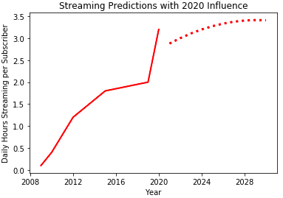
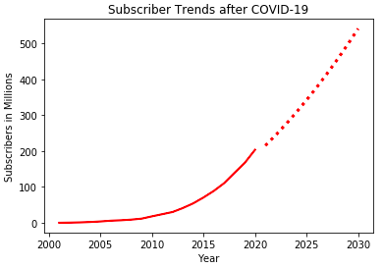
Projected Footprint Netflix Streaming
Streaming patterns (for 2021 and 2022 especially) are difficult to estimate due to unprecedented pandemic effect
Subscription trends may be more accurate due to consistent upturn over the years
Notes:
Data sourcing: Netflix does not publish this data - gathered from third party analysis from February of 2021 and consolidated to make linear regressions with polynomial features to account for curves.
Streaming Predictions potential problems
Will hours per day drop as people return to work/social lives and then return to normal trend?
Will they stay elevated beyond normal after covid but continue normal trend?
Subscriber Predictions probably decent due to relatively consistent trend in past years
Both streaming hours per day and subscriber trends probably have a limit somewhere - there is only so much time in a day to spend watching Netflix (work, family, friends, hobbies, etc.) and some people will never subscribe

Slide 10
Projected Footprint Netflix Streaming
Year | Subscribers (M) | Daily Hours (per Subscriber) | Total Yearly Streaming Hours (T) | Total Electricity Used (kWh) | Total Carbon Footprint (T lbs CO₂)
2021 | 215.4 | 2.88 | 226.4 | 17.4 | 16.0
2022 | 244.4 | 3.00 | 267.7 | 20.6 | 18.9
2028 | 455.9 | 3.40 | 566.3 | 43.6 | 40.1
2029 | 497.5 | 3.41 | 619.9 | 47.7 | 43.9
2030 | 540.8 | 3.41 | 672.9 | 51.8 | 47.7
Notes:
Table of projected footprint results from our regressions
Using the conversions for hours to kWh to pounds of carbon dioxide, we use our predicted data to make calculations for the carbon footprint in 2021 through 2030
Year, subscribers in millions, daily hours per subscriber, total streaming hours per year in trillions, total kWh in trillions, and the pounds of carbon dioxide emitted from streaming per year in trillions.
As we can see, subscribers continue to increase but daily hours slows in rate of change between years, meaning that the total carbon footprint increases more from the increase in subscribers than continued increase in hours of streaming.

Slide 11
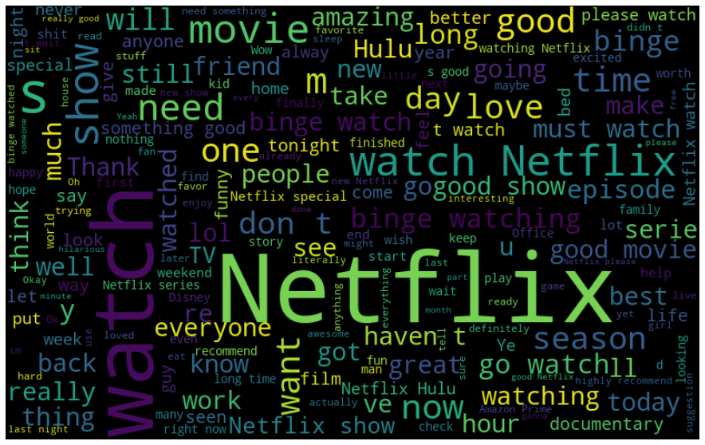
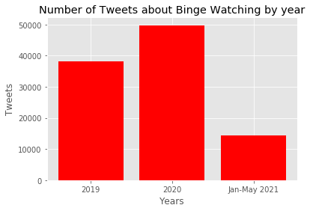
Netflix Sentiment Analysis via Twitter
Sentiment Analysis
Tweet Mention Volume
Notes:
We scraped twitter to look at consumer sentiment about binge-watching and the environment.
Showing binge watching sentiment analysis from 201
Shows an increase of tweets in 2020
During our analysis we found that we often talk about what they are watching and occasionally how long they are watching.
Netflix gained more subscribers, hours and tweets in 2020

Slide 12
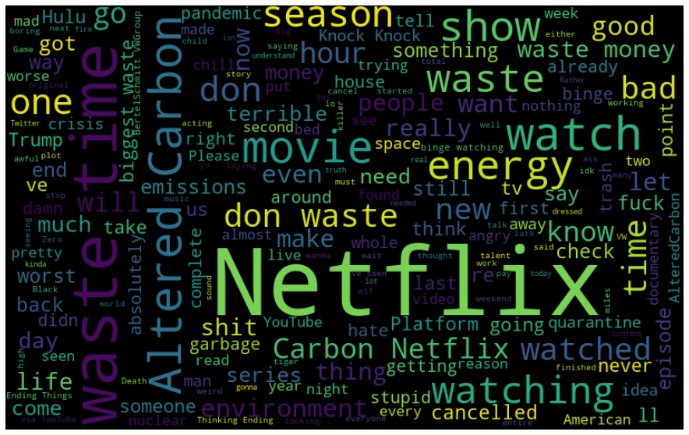
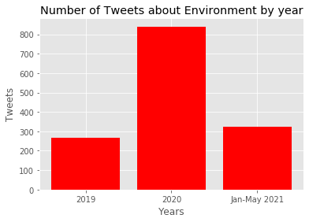
Netflix Sentiment Analysis via Twitter
Sentiment Analysis
Tweet Mention Volume
Notes:
Showing negative Environment from 2020
We’ve seen a great increase in discussion about netflix and the environment during 2020 (and the pandemic)
We found that while some people talk about Netflix’s impact on the environment, consumers also talk about the environmental documentaries on Netflix

Slide 13


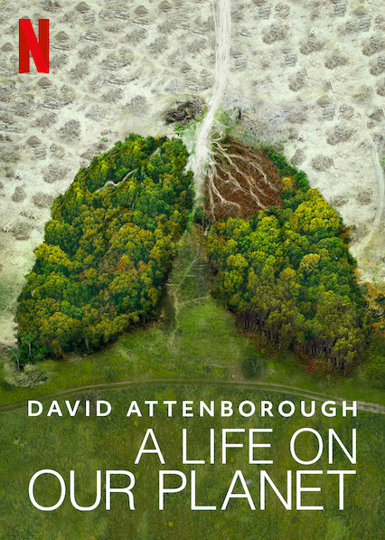
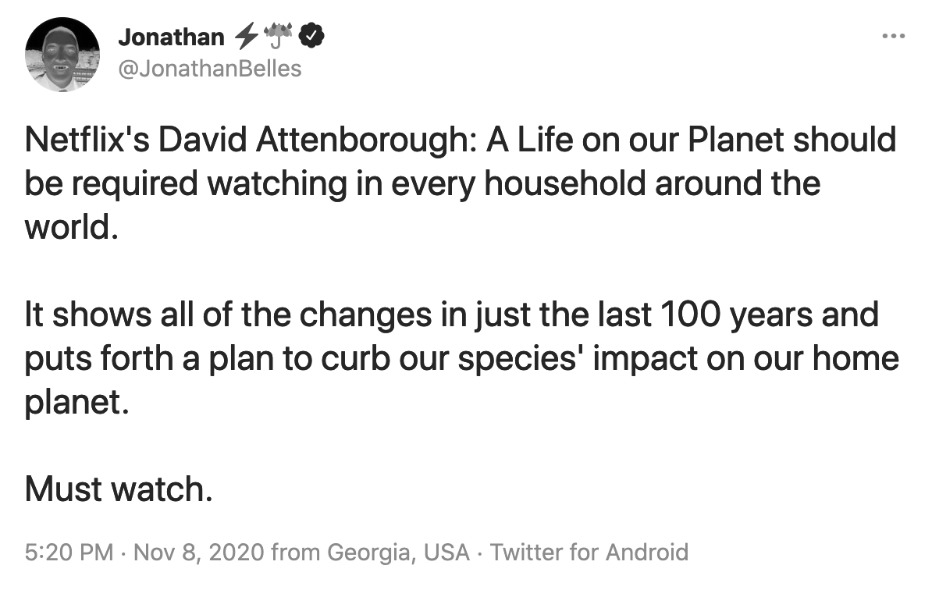
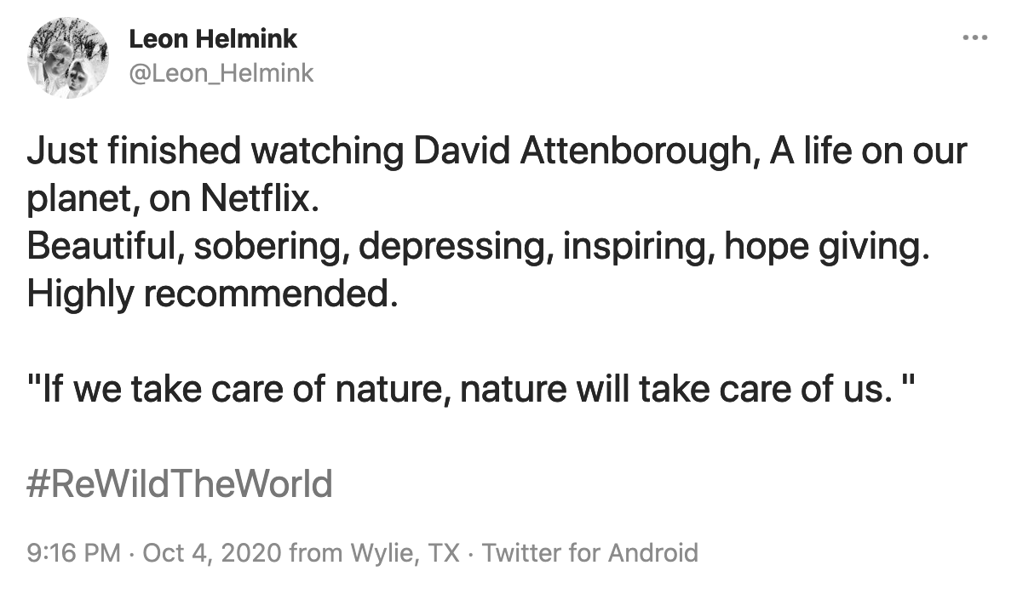
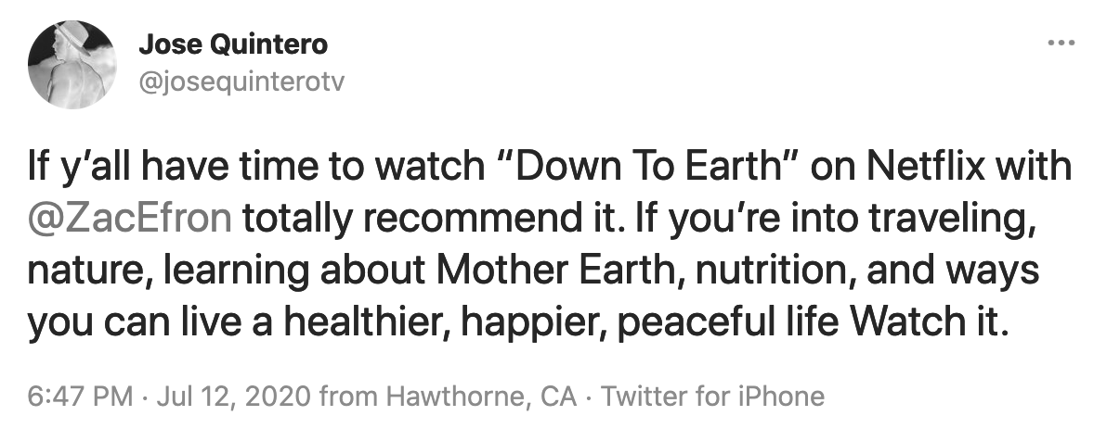
netflix 2020 Environmental Documentaries
% positive or neutral tweets
95%
93%
84%
Notes:
Jackson

Slide 14
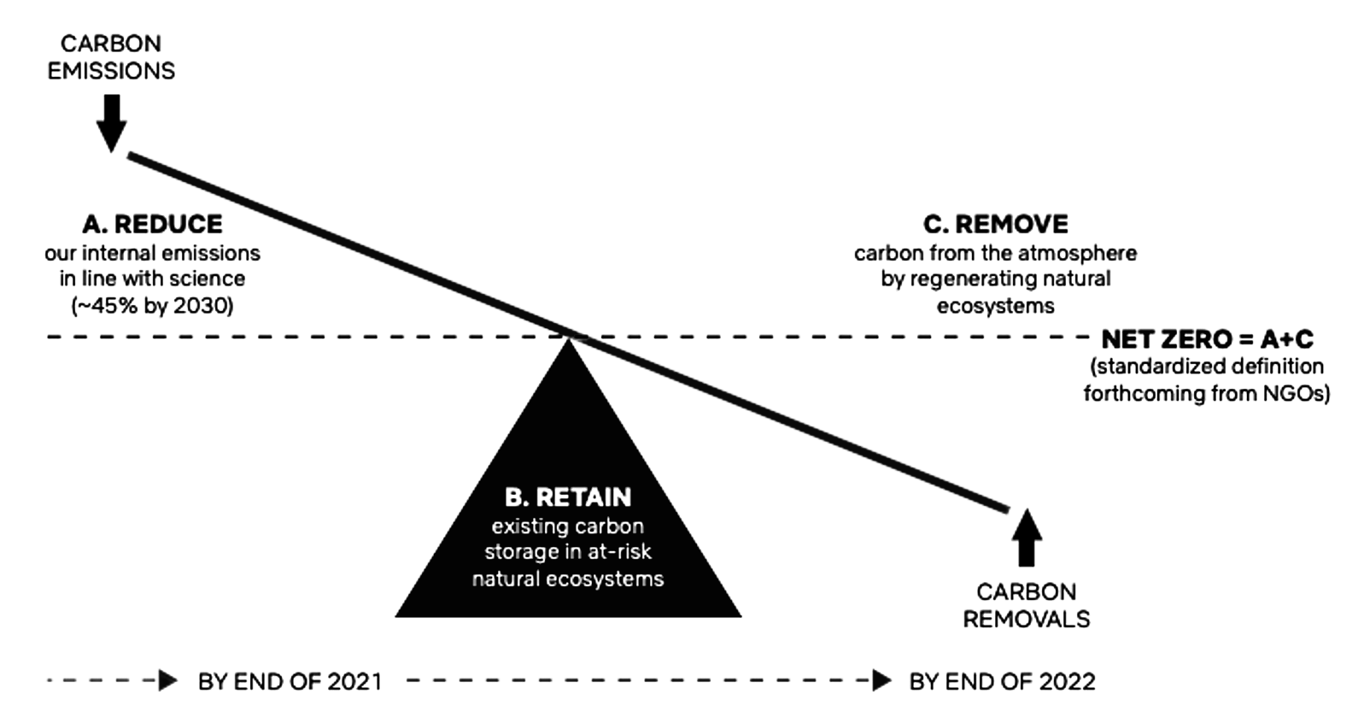
Netflix can be Carbon Neutral by 2022 if they...
Net zero + Nature plan
Notes:
Through Netflix’s Net Zero + Nature Plan, Netflix plans to achieve net zero greenhouse gas emissions by the end of 2022 and every year thereafter through a 3 pronged approach (Dr. Ringel’s favorite!)
REDUCE→ reducing internal emissions in line with Paris Agreement’s goal to limit by reducing scope 1 & 2 emissions by 45% by 2030
However, Netflix doesn’t currently include carbon emissions generated from the internet transmission or electronic devices used by viewers to stream Netflix (current best practice is for internet service providers & device manufacturers to account for these emissions because they have operational control)
RETAIN→ fully neutralize emissions that can’t be avoided internally through investments in projects that prevent carbon from entering the atmosphere
REMOVE → incorporate investments in regenerations of critical natural ecosystems
Restoring grasslands, mangroves,& healthy soils to remove and store carbon from the atmosphere

Slide 15





Decarbonizing Streaming Delivery
Focus on Netflix's Value Chain partners: their Data Center providers
Netflix’s Data Centers use cloud providers and co-location data centers to deliver streaming (emissions from these providers are included in their climate target boundary)
Open Connect Program works with internet service providers to provide streaming through servers hosted closer to the consumer, which highly energy efficient because storing content closer to users allows Netflix to:
Avoid building and maintaining international networks (can be carbon intensive due to laying infrastructure over long distances -- through land or water)
Avoid congesting the internet traffic loads of routers when delivering streaming
Use less data by delivering content to consumers from a closer location
Coalition Formation: Create coalition agreement with internet service providers & electronic device producers to formally recognize their relationship with Netflix and their efforts to decarbonize their networks & reduce devices emissions during use; Continuing their utilization of DIMPACT research to assess life cycle carbon footprinting and emissions of video streaming
Notes:
Capitalize on consumers increased important on environmental impact
First mover/adopter advantage
Encourage data center and other technology partners to continue decarbonizing their energy supply and disclose details to their customers

Slide 16
Capitalize on consumer importance placed on environmental impact
Establish Responsibility
Further Educational Content
Formalize relationship with internet service providers and technology producers to establish accountability for their decarbonization efforts in the streaming industry
Allows Netflix to capitalize on the increase in consumer concerns regarding the environment impact of firms’ actions
Promote environmentally conscious content and continue to encourage subscribers to educate themselves on environmental issues
Allows Netflix to position itself as a company that advocates for positive environmental change, and potentially bring in this demographic as customers
Notes:
Capitalize on consumers increased important on environmental impact
First mover/adopter advantage
(840 Netflix-related tweets in 2020 about the environment and 266 in 2019) → 215% increase

Slide 17
QUESTIONS?
Please keep this slide for attribution

Slide 20
TEMPLATE WITH WORDARTS
This is WordArt text. If you want to modify it:
Double click on it
Type your new text in the dialog box
You can change the fill color in the top menu
You can also modify the stroke, its color, thickness or type
Press Enter
Hi!

Slide 21
OUR COMPANY
Here you could give a brief description of the topic you want to talk about. For example, if you want to talk about Mercury, you could say that it’s the smallest planet

Slide 22
ABOUT US
01
You could enter a subtitle here if you need it

Slide 23

ABOUT THE PRODUCT
Do you know what helps you make your point clear? Lists like this one:
They’re simple
You can organize your ideas
You’ll never forget to buy milk!
And the most important thing: the audience won’t miss the point of your presentation

Slide 24
OUR GOALS
A
B
C
Mars
Jupiter
Mercury
Despite being red, Mars is actually a very cold place. It's full of iron oxide dust
It's the fourth-brightest object in the night sky. It was named after the Roman god of the skies
Mercury is the closest planet to the Sun and the smallest one in the Solar System

Slide 25
WHAT SETS US APART?
Mercury
Venus
This planet's name has nothing to do with the liquid metal. It was named after the Roman messenger god
Venus has a beautiful name and is the second planet from the Sun. It’s terribly hot, even hotter than Mercury

Slide 26
CORE VALUES
25%
25%
25%
25%
Dad
MoM
Mercury is the smallest planet
Jupiter is a gas giant planet
Daughter
Son
Mars is actually a cold place
Neptune is the farthest planet

Slide 27
—SOMEONE FAMOUS
“This is a quote, words full of wisdom that someone important said and can make the reader get inspired”

Slide 28
COMPETITOR ANALYSIS
COMPETITOR | STRENGTHS | WEAKNESSES
Jupiter | Here you can list your competitor’s strengths | Here you can list your competitor’s weaknesses
Saturn | Here you can list your competitor’s strengths | Here you can list your competitor’s weaknesses
Neptune | Here you can list your competitor’s strengths | Here you can list your competitor’s weaknesses

Slide 29

MARKET SEGMENTATION
35%
20%
30%
15%
CABLE
SATELLITE
Jupiter is a gas giant planet
Venus has a beautiful name
INTERNET
OTHERS
Follow the link in the graph to modify its data and then paste the new one here. For more info, click here
Mars is actually a cold place
Neptune is the farthest planet

Slide 30
STRATEGY
Mercury
Venus
Neptune
It’s the closest planet to the Sun
Venus is the second planet from the Sun
It’s the farthest planet from the Sun
Saturn
Jupiter
Mars
Saturn is composed mostly of hydrogen
Jupiter is the biggest planet of them all
Despite being red, Mars is a cold place

Slide 31

A PICTURE IS WORTH A THOUSANDS WORDS

Slide 32
AWESOME
WORDS

Slide 33

PRODUCT DESCRIPTION
A
C
B
D
Venus
Mercury
Venus is the second planet from the Sun
Mercury is the closest planet to the Sun
Mars
Jupiter
Despite being red, Mars is a cold place
It’s the biggest planet in the Solar System

Slide 34
PRICING
$12
$20
$26
BASIC
STANDARD
PREMIUM
Saturn is a gas giant and has several rings
Despite being red, Mars is a cold place
Venus is the second planet from the Sun

Slide 35
24,000
38,600
45,700
Listen to music on the record player
Watch music show on streaming service
Are satisfied with our music playlist

Slide 36
489,300.00
Big numbers catch your audience’s attention

Slide 37
DISTRIBUTION CHANNELS
PRODUCER
CONSUMER
provider
CONSUMER
distributor
provider
CONSUMER

Slide 38

PROMOTION
MULTIMEDIA
Despite being red, Mars is actually a cold place
PRESS
It’s a gas giant and the biggest planet in the Solar System
MOBILE APP
It’s the closest planet to the Sun and the smallest one

Slide 39
ADVERTISING CAMPAIGN 1
Social media
$25,000
GOALS
BUDGET
DESCRIPTION
Mercury is the closest planet to the Sun and the smallest
Venus has a beautiful name, but it’s terribly hot
Despite being red, Mars is actually a very cold place

Slide 40
ADVERTISING CAMPAIGN 2
BILLBOARD
BUDGET
GOALS
DESCRIPTION
$40,000
Mercury is the closest planet to the Sun and the smallest
Venus has a beautiful name, but it’s terribly hot

Slide 41
PR OUTREACH
CHANNELS
GOALS
KEY MESSAGES
Social Media
Mercury is the smallest planet
Venus has a beautiful name
Earth is where we all live on
50%
Radio
Your goal
Press
80%
Web
Your other goal

Slide 42
BUDGET ALLOCATION
JUPITER | MERCURY | NEPTUNE | VENUS
$2,000 | $3,100 | $400 | $1,300
$3,400 | $600 | $200 | $100
$1,700 | $800 | $2,500 | $700

Slide 43
PREDICTED REACH
20,000
10,000
FOLLOWERS
Jupiter is a gas giant planet
mentions
Neptune is the farthest planet

Slide 44
YOU CAN USE A TIMELINE
1953
1986
2019
2052
CHARACTER 01
CHARACTER 02
CHARACTER 03
CHARACTER 04
Venus has a lovely name
Mars is a very cold place
Mercury is the smallest planet
Jupiter is the biggest planet

Slide 45
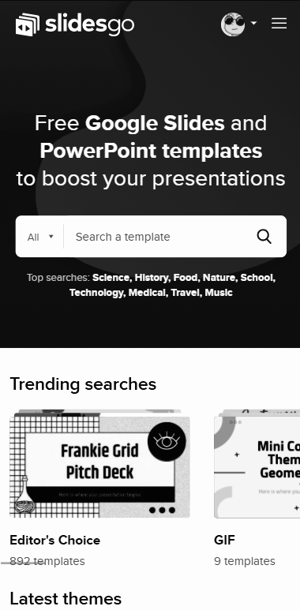
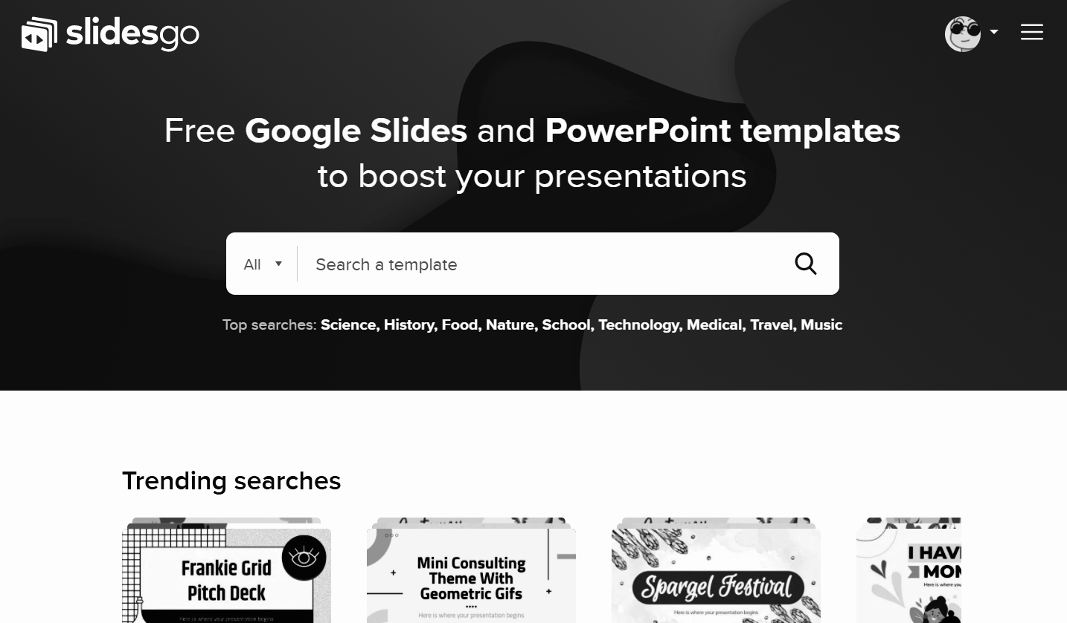
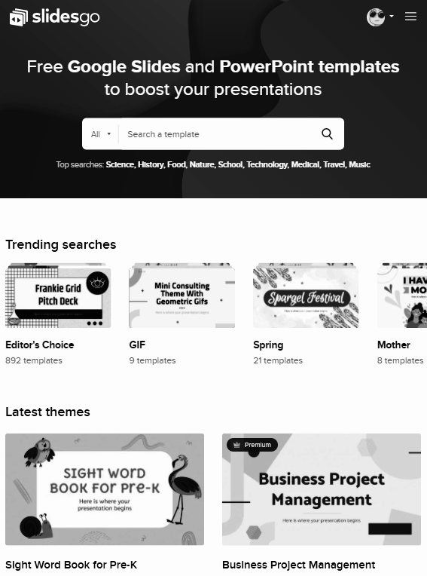
MULTIMEDIA
You can replace the image on the screen with your own work. Right-click on it and then choose "Replace image" (in Google Slides) or "Change Picture" (in PPT) so you can add yours

Slide 46

OUR TEAM
CHRIS doe
Here you can talk a bit about this person
gina doe
Here you can talk a bit about this person

Slide 47
ALTERNATIVE RESOURCES
Here’s an assortment of alternatives resources within the same style of this template

Slide 48
RESOURCES
Did you like the resources? Get them for free at our other websites.
ILLUSTRATIONS
Set eighties objects flat design
Vintage cartoon furniture
Variety furniture vintage objects
PHOTOS
Women sitting sofa staring while watching television
Popcorn juice movie night
Crop man choosing netflix account
Man sitting beside his boyfriend
Portrait of smiling interracial young couple

Slide 49
Instructions for use (free users)
In order to use this template, you must credit Slidesgo by keeping the Thanks slide.
You are allowed to:
Modify this template.
Use it for both personal and commercial purposes.
You are not allowed to:
Sublicense, sell or rent any of Slidesgo Content (or a modified version of Slidesgo Content).
Distribute this Slidesgo Template (or a modified version of this Slidesgo Template) or include it in a database or in any other product or service that offers downloadable images, icons or presentations that may be subject to distribution or resale.
Use any of the elements that are part of this Slidesgo Template in an isolated and separated way from this Template.
Delete the “Thanks” or “Credits” slide.
Register any of the elements that are part of this template as a trademark or logo, or register it as a work in an intellectual property registry or similar.
For more information about editing slides, please read our FAQs or visit Slidesgo School:
https://slidesgo.com/faqs and https://slidesgo.com/slidesgo-school

Slide 50
Instructions for use (premium users)
In order to use this template, you must be a Premium user on Slidesgo.
You are allowed to:
Modify this template.
Use it for both personal and commercial purposes.
Hide or delete the “Thanks” slide and the mention to Slidesgo in the credits.
Share this template in an editable format with people who are not part of your team.
You are not allowed to:
Sublicense, sell or rent this Slidesgo Template (or a modified version of this Slidesgo Template).
Distribute this Slidesgo Template (or a modified version of this Slidesgo Template) or include it in a database or in any other product or service that offers downloadable images, icons or presentations that may be subject to distribution or resale.
Use any of the elements that are part of this Slidesgo Template in an isolated and separated way from this Template.
Register any of the elements that are part of this template as a trademark or logo, or register it as a work in an intellectual property registry or similar.
For more information about editing slides, please read our FAQs or visit Slidesgo School:
https://slidesgo.com/faqs and https://slidesgo.com/slidesgo-school

Slide 51
Fonts & colors used
This presentation has been made using the following fonts:
Bebas Neue
(https://fonts.google.com/specimen/Bebas+Neue)
Lato
(https://fonts.google.com/specimen/Lato)
#0d0d0d
#ffffff
#b92f2f
#a52525
#7a2020
#c98888

Slide 52





Storyset
Create your Story with our illustrated concepts. Choose the style you like the most, edit its colors, pick the background and layers you want to show and bring them to life with the animator panel! It will boost your presentation. Check out How it Works.
Pana
Amico
Bro
Rafiki
Cuate

Slide 53
Use our editable graphic resources...
You can easily resize these resources without losing quality. To change the color, just ungroup the resource and click on the object you want to change. Then, click on the paint bucket and select the color you want. Group the resource again when you’re done. You can also look for more infographics on Slidesgo.

Slide 56
JANUARY
FEBRUARY
MARCH
APRIL
MAY
JUNE
PHASE 1
Task 1
Task 2
PHASE 2
Task 1
Task 2
JANUARY
FEBRUARY
MARCH
APRIL
PHASE 1
Task 1
Task 2

Slide 59
...and our sets of editable icons
You can resize these icons without losing quality.
You can change the stroke and fill color; just select the icon and click on the paint bucket/pen.
In Google Slides, you can also use Flaticon’s extension, allowing you to customize and add even more icons.

Slide 60
Educational Icons
Medical Icons

Slide 61
Business Icons
Teamwork Icons

Slide 62
Help & Support Icons
Avatar Icons

Slide 63
Creative Process Icons
Performing Arts Icons

Slide 64
Nature Icons

Slide 65
SEO & Marketing Icons

Slide 66


